Slide 1
Enterprise Computing – Assignment 2
Winter Term 2019/20
Ankush Sharma
415319

Slide 2
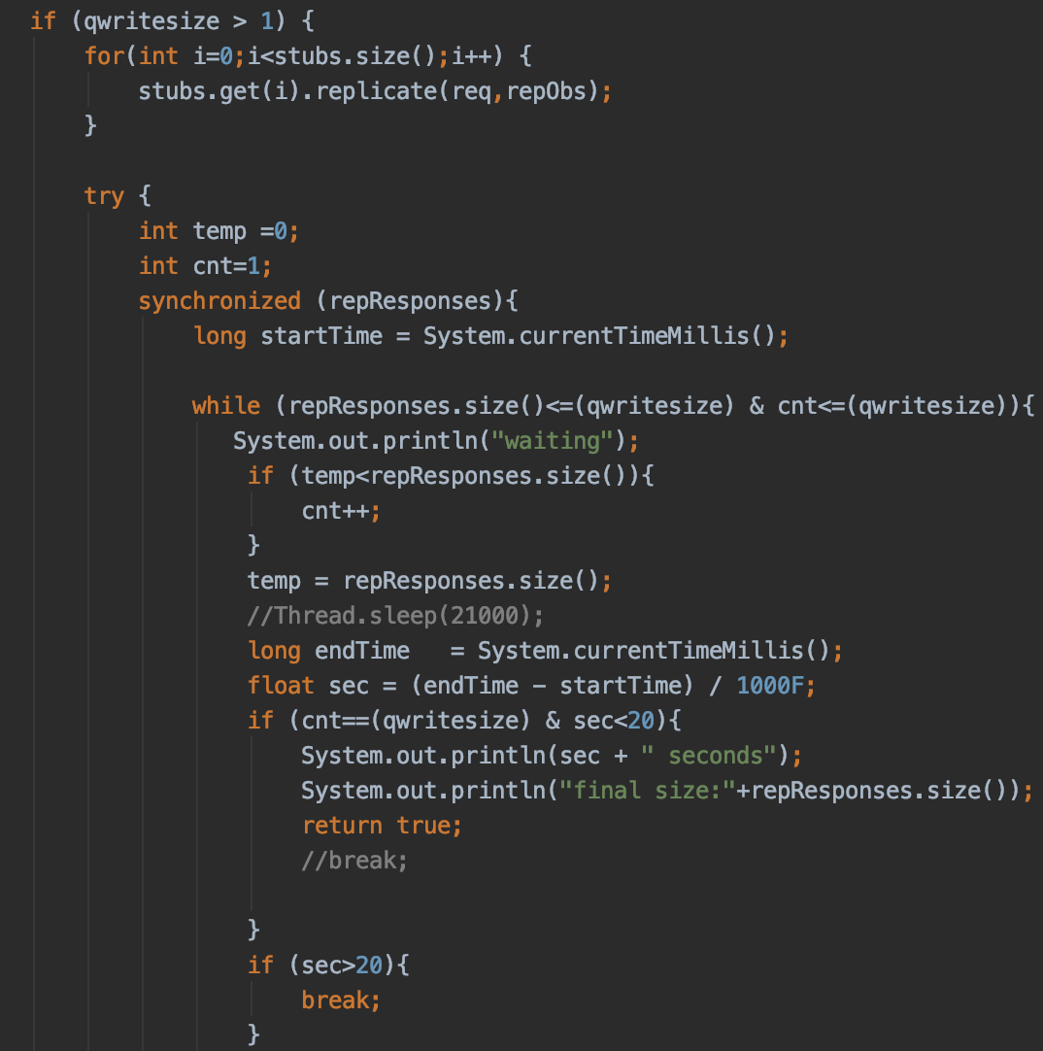
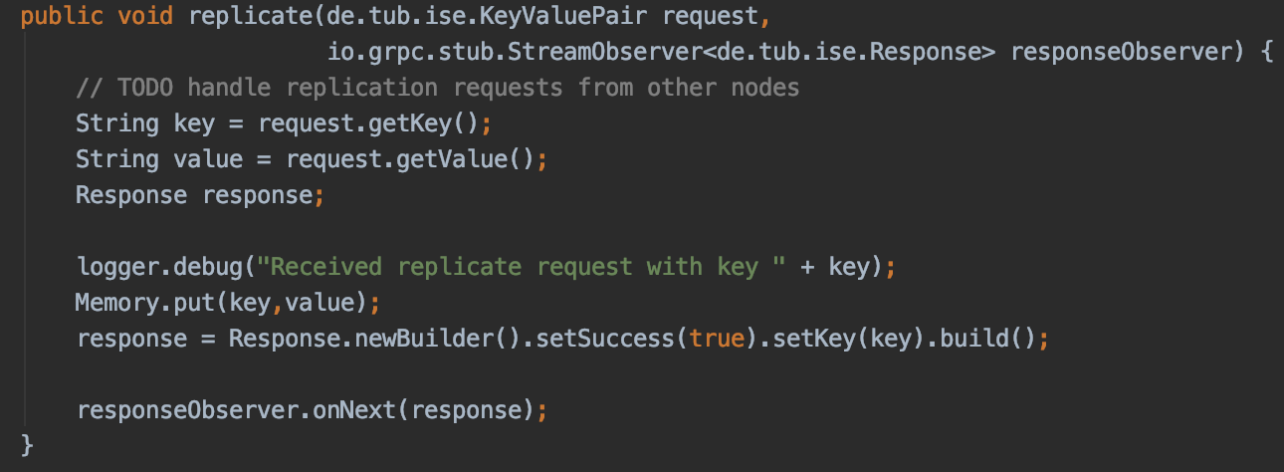
Replicate() and ReplicateData()
After client calls put(), replicateData() is called to replicate between nodes. This function calls replicate() that writes the data to memory of other nodes as shown in the picture.
If the qwritesize is 1, the response would be immediately sent to the client. Else, a thread safe variable (cnt) is used to count the number of responses received from the StreamObserver that stores the response array from other nodes. When this variable (cnt) equals qwritesize, the success response would be sent to client. If the timeout is more than 20 seconds or if cnt is not equal to qwritesize, failure response would be sent

Slide 3
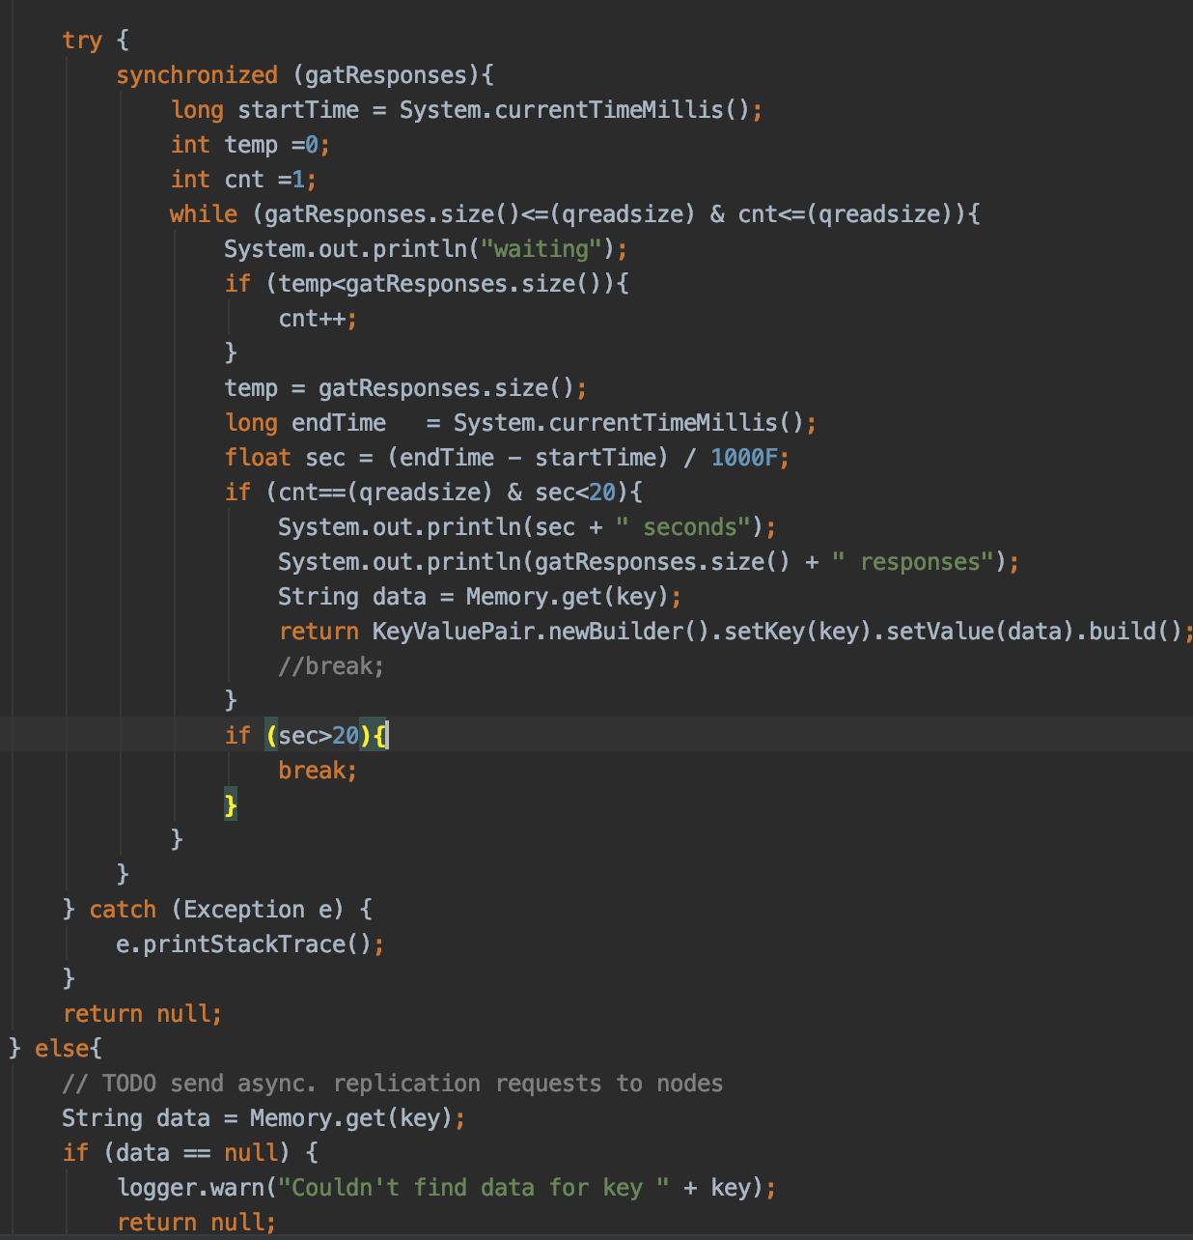
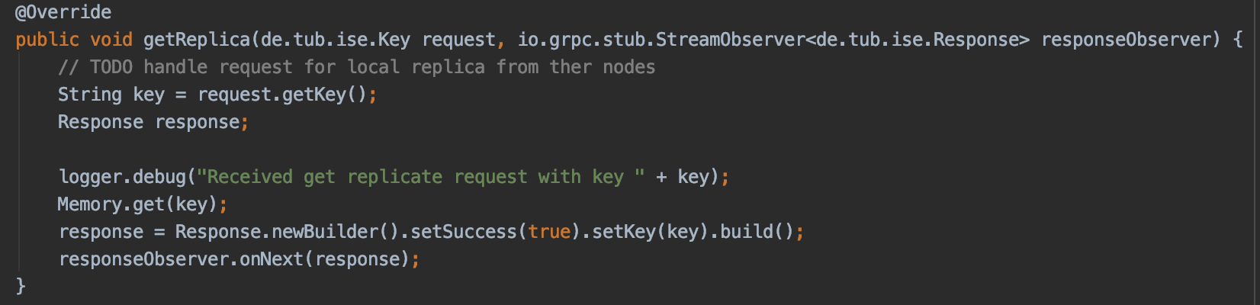
getReplica() and gatherdata
After client calls get(), gatherData() is called to replicate between nodes. This function calls getReplica() that reads the data from memory of other nodes as shown in the picture.
If the qreadsize is 1, the response would be immediately sent to the client. Else, a thread safe variable (cnt) is used to count the number of responses received from the StreamObserver that stores the response array from other nodes. When this variable (cnt) equals qreadsize, the success response would be sent to client. If the timeout is more than 20 seconds or if cnt is not equal to qreadsize, failure response would be sent

Slide 4
Replication Strategy
For this experiment we have tuned the values of N, R and W to achieve their desired levels of performance, availability and durability
However, it can be clearly seen that Low values of W and R can increase the risk of inconsistency as write requests are deemed successful and returned to the clients even if they are not processed by most of the replicas
(3,2,2). have always been chosen to meet the necessary levels of performance, durability, consistency, and availability SLAs which we also validated during our experiments.
We tested our system with three different quorum-configurations (N,R,W):
  (3,1,3)
  (3,2,2)
  (3,3,1)

Slide 5
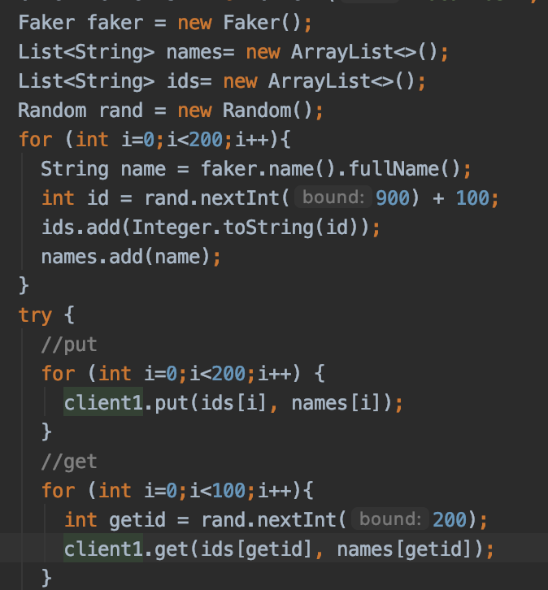
Benchmarking
In client.java,Faker() has been used to generate 200 random values which are stored in names
Random() has been used to generate 200 random 3-digit numbers for keys which
Put(): These randomly generated values stored in ids and names are used as arguments for client.put()
Get(): 100 ids from these 200 are randomly selected and used for client.get()
Similarly We used such system by changing values of quorum and evaluating system

Slide 6
Results and Analysis
Method | Numbers
Put | 200
Get | 100
To run the analysis, 200 write request,100 read requests have been generated
During this analysis, we recorded few observations as failed(more than 20 secs).To perform further analysis on latency we considered only the successful calls.

Slide 7
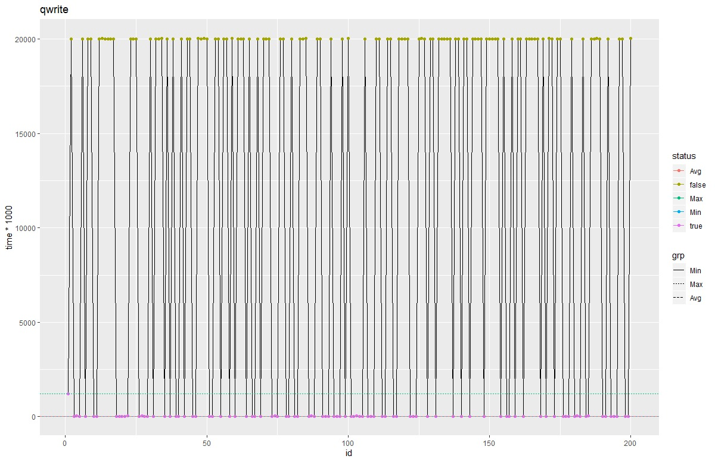
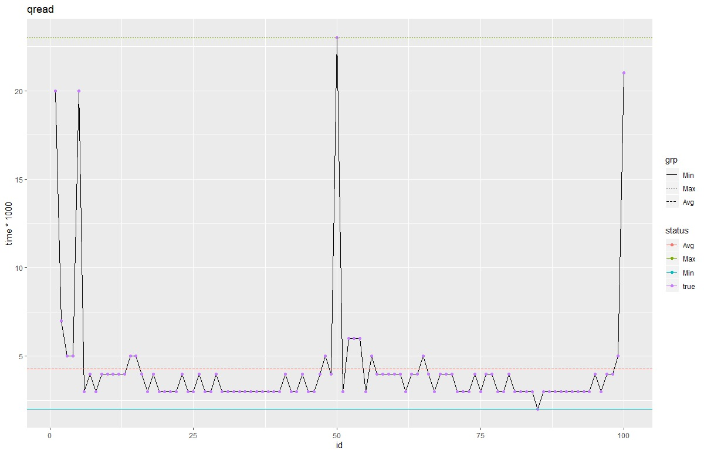
Results and Analysis for 1R,3W
Quorum | Min | Max | Average | Failed
Put | 5 | 1221 | 23,9 | 106
Get | 2 | 23 | 4,3 | 0
* Values of Min,Max,Average latency are in milisecs

Slide 8
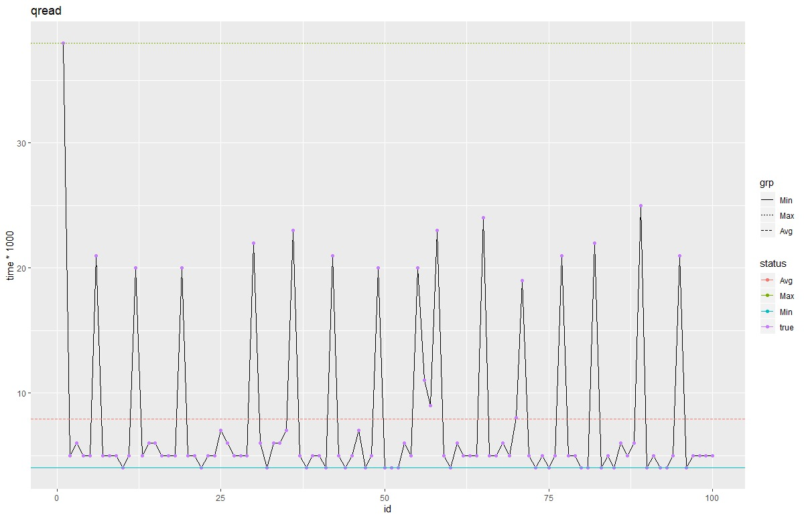
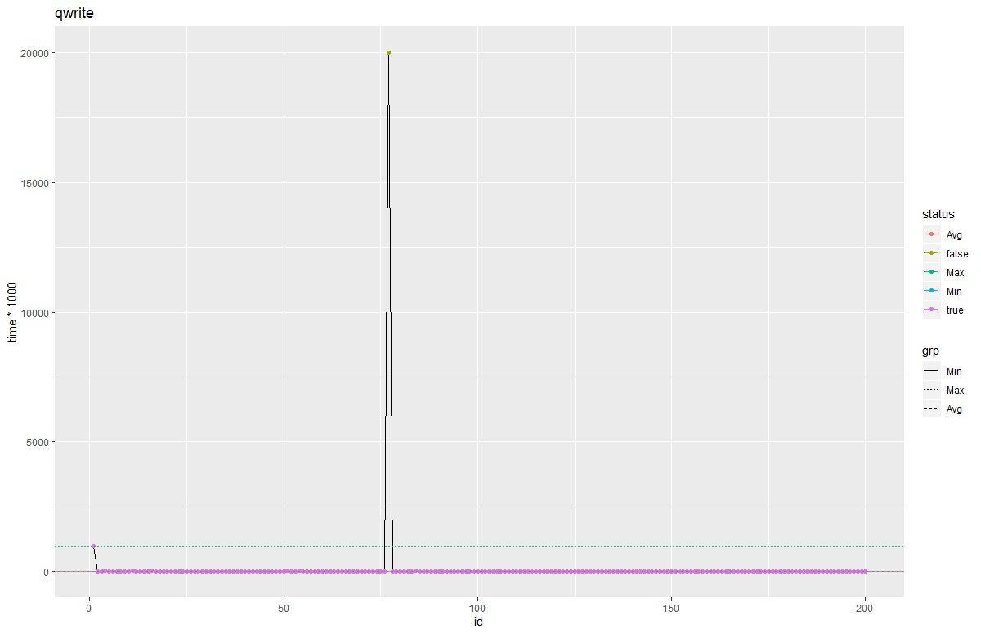
Results and Analysis for 2R,2W
Quorum | Min | Max | Average | Failed
Put | 4 | 997 | 15,6 | 1
Get | 4 | 38 | 7,9 | 0
Graphs
* Values of Min,Max,Average latency are in milisecs

Slide 9
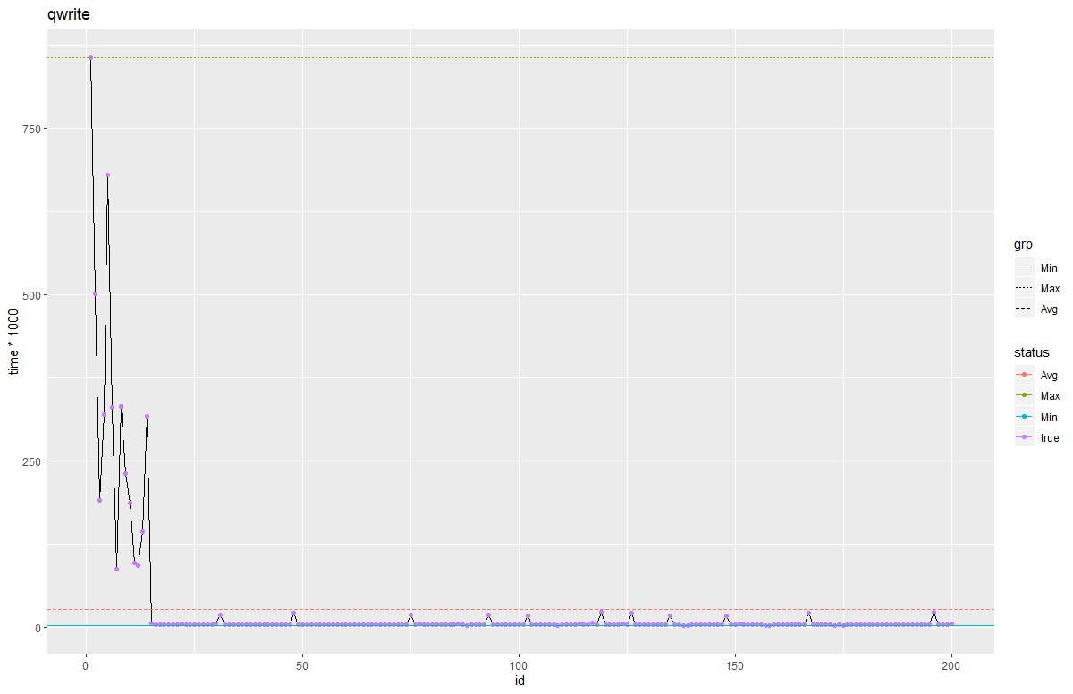
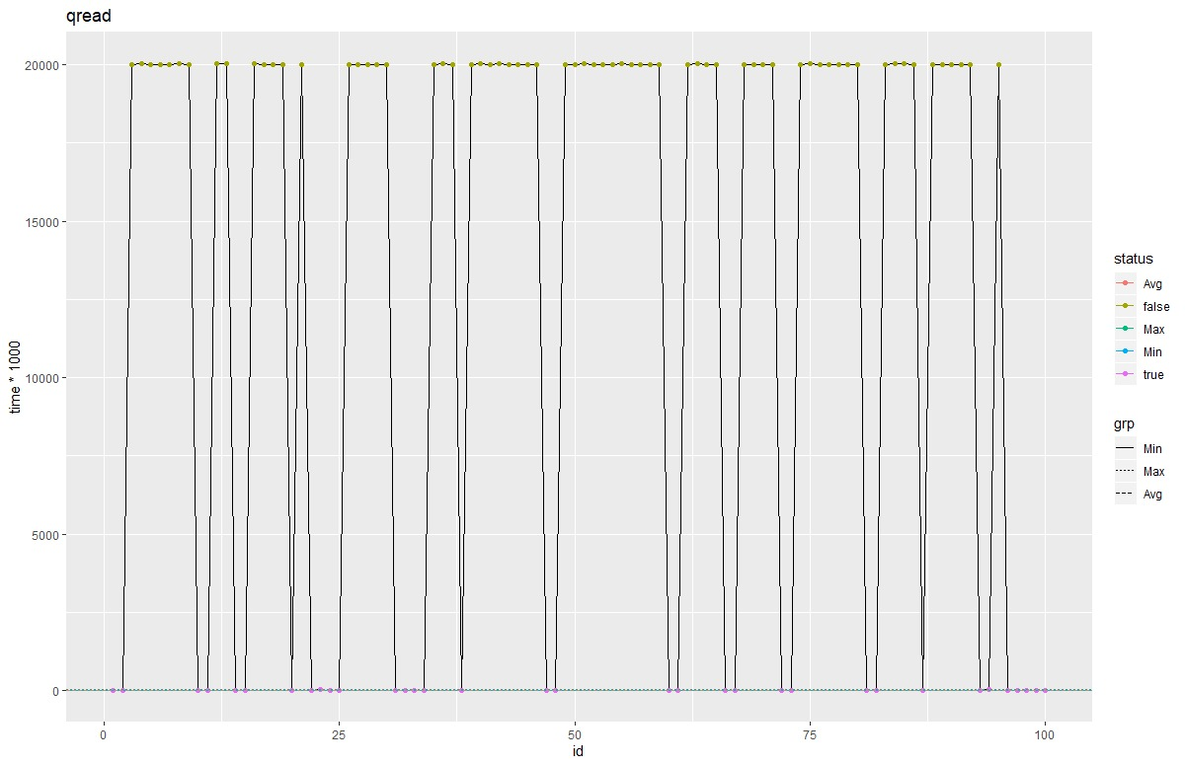
Results and Analysis for 3R,1W
Quorum | Min | Max | Average | Failed
Put | 2 | 856 | 25.87 | 0
Get | 3 | 38 | 8.5 | 66
Graphs
* Values of Min,Max,Average latency are in milisecs

Slide 10
Results and Discussion
We can check and validate from the above results that quorum-configurations (N,R,W) as (3,2,2) is the most efficient in terms of latency and less failed calls

Slide 11
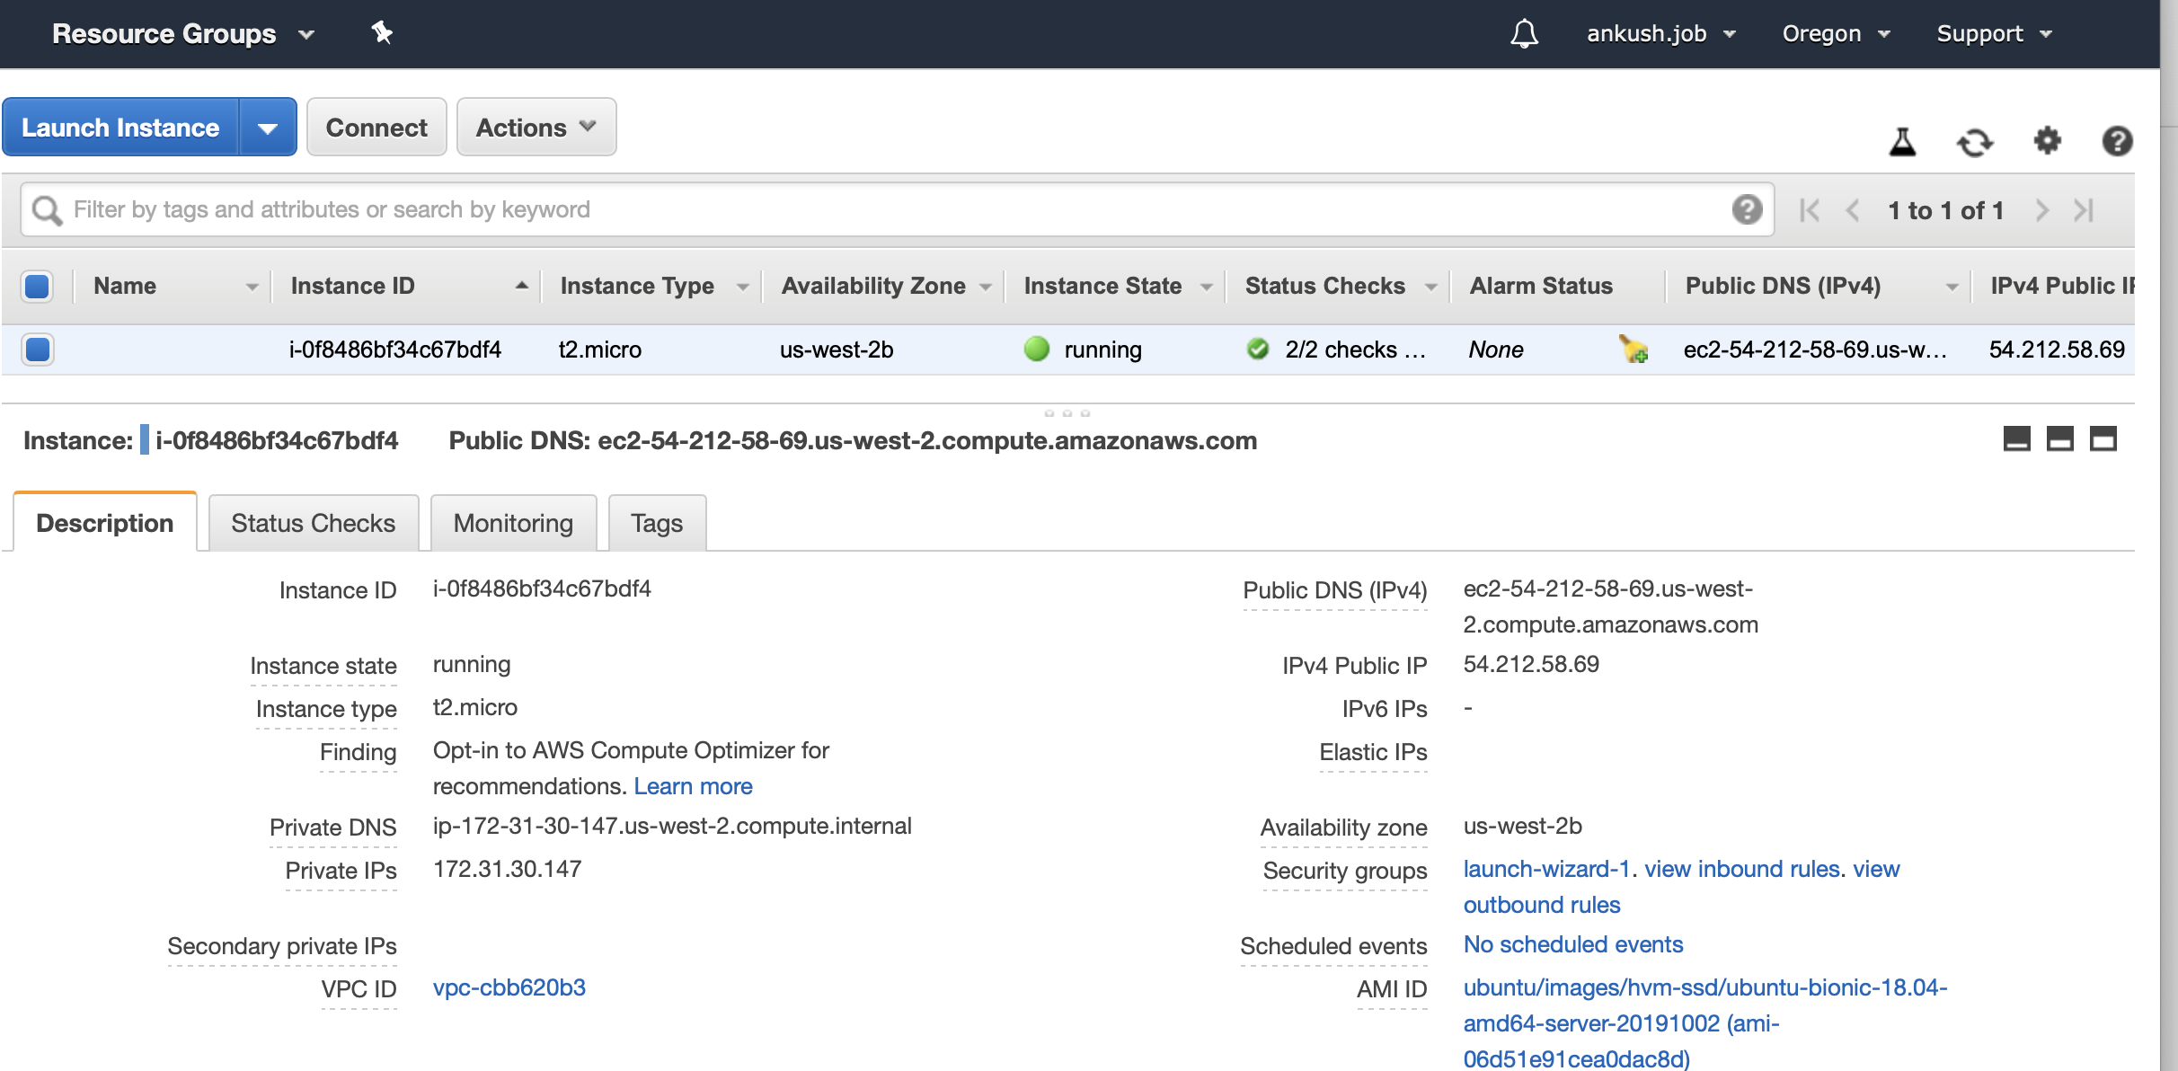
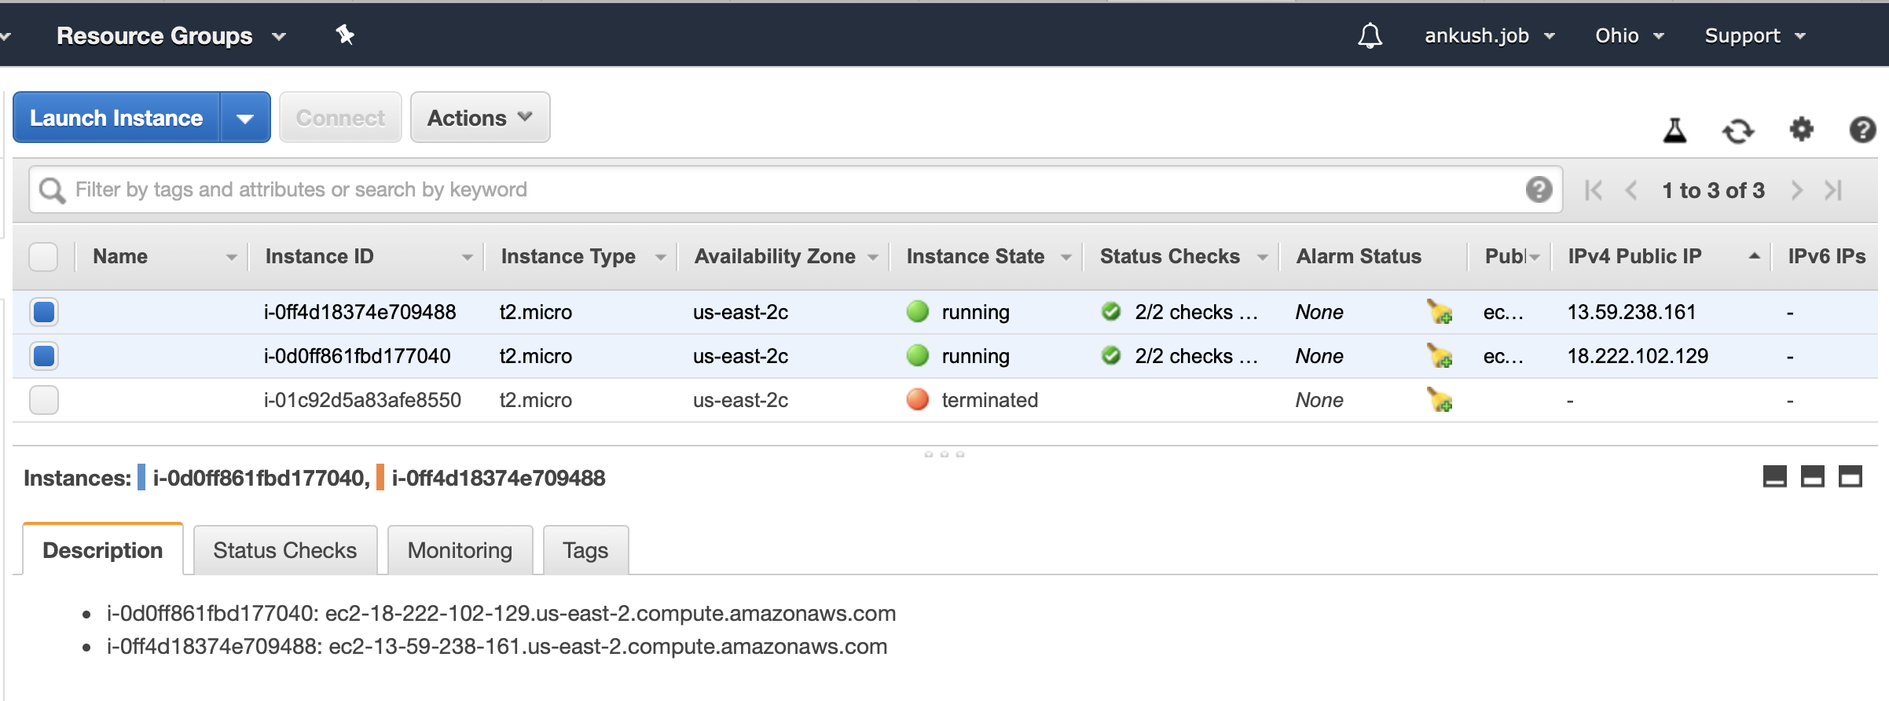
AWS Cloud Console
For this assignment ,I have used 2 Instances in US East (Ohio)us-east-2 Zone (with Public IP Addresses 18.222.102.129 & 13.59.238.161) and 1 instance in US West (Oregon) us-west-2 (Public IP Address :-54.212.58.69)

